Slide 1
Time-Series.
Deep
Learning
"Artificial intelligence could be the greatest event in human history,
or the worst.
If we are not prepared, it could be the worst.”
By Stephen William Hawking
BY TAE YOUNG

Slide 2
00.
"Artificial intelligence could be the greatest event in human history,
or the worst.
If we are not prepared, it could be the worst.”
By Stephen William Hawking
Time-Series
Deep Learning
DATA SCALING
&
INTRODUCE
DATA
Pre Knowledge
EDA
KODEX 200
Deep Learning?
Time-Series?
Correlation
Time-Series
Robust
&
Model
HRD_TY PROJECT 1
HRD_TY PROJECT 2
HRD_TY PROJECT 3
HRD_TY PROJECT 4

Slide 3
00.
"Artificial intelligence could be the greatest event in human history,
or the worst.
If we are not prepared, it could be the worst.”
By Stephen William Hawking
Time-Series
Deep Learning
LSTM
RNN
GRU
TRANSFORMER
Long Short
Term
Memory
Recurrent
Neural
Network
Gated
Recurrent
Units
By Google
HRD_TY PROJECT 5
HRD_TY PROJECT 6
HRD_TY PROJECT 7
HRD_TY PROJECT 8

Slide 4
00.
"Artificial intelligence could be the greatest event in human history,
or the worst.
If we are not prepared, it could be the worst.”
By Stephen William Hawking
Time-Series
Deep Learning
Conclude
QnA
R squared
Prediction
QnA
HRD_TY PROJECT 9
HRD_TY PROJECT 10

Slide 5
Data
01.
FINANCE DATA READER.
KODEX 200.

Slide 6
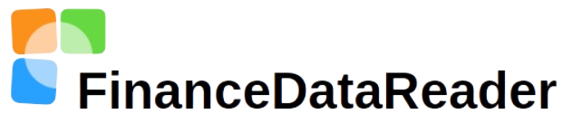
01.
"Artificial intelligence could be the greatest event in human history,
or the worst.
If we are not prepared, it could be the worst.”
By Stephen William Hawking
FINANCE
DATA
READER
FINANCE.
한국, 미국 주식데이터 / 암호화폐 가격 등을 제공하는
Python API 패키지
https://github.com/FinanceData/FinanceDataReader
A.

Slide 7
01.
"Artificial intelligence could be the greatest event in human history,
or the worst.
If we are not prepared, it could be the worst.”
By Stephen William Hawking
KODEX
200
KODEX 200?
ETF.
초보자도 할 수 있음 – 도메인이 없는 사람에게 적절
자산규모가 큼 - 오로지 숫자로 판단하기 용이
우리나라를 대표하는 주식들로 구성
B.

Slide 8
Knowledge
02.
AI, ML, DL.
NEURAL NETWORK.
DEEP LEARNING MODEL.
TIME - SERIES.

Slide 9
02.
"Artificial intelligence could be the greatest event in human history,
or the worst.
If we are not prepared, it could be the worst.”
By Stephen William Hawking
AI, ML, DL
AI
인공지능(Artificial Intelligence)
사람이 해야 할 지능적인 일을
기계가 대신해주는 모든 자동화
ML
머신 러닝(Machine Learning)
데이터로부터 의사결정을
기계 스스로 학습
데이터와 해답을 가지고 규칙을 도출
DL
딥러닝(Deep Leaning)
인공 신경망 모델의 일종
데이터의 특징 추출부터 판단까지
기계가 한번에 수행

Slide 10
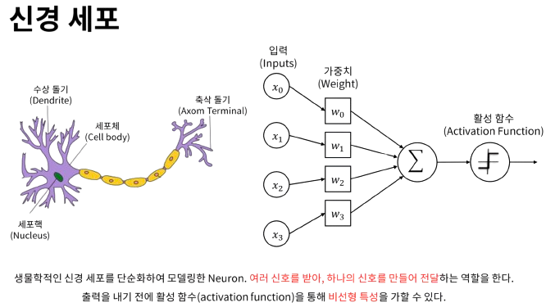
02.
"Artificial intelligence could be the greatest event in human history,
or the worst.
If we are not prepared, it could be the worst.”
By Stephen William Hawking
신경망
NEURAL NETWORK.
A.
신경망이란 뇌 구조를 이해하는 것에서부터 영감을 얻어 개발됨
딥러닝 자체가 뇌를 모델링한 것은 아님.
많은 곳에서 뇌를 모방했다고 주장하지만, 사실이 아님
데이터로부터 표현을 학습하는 수학 모델일 뿐임
그림 출처 : https://heung-bae-lee.github.io/2019/12/06/deep_learning_01/

Slide 11
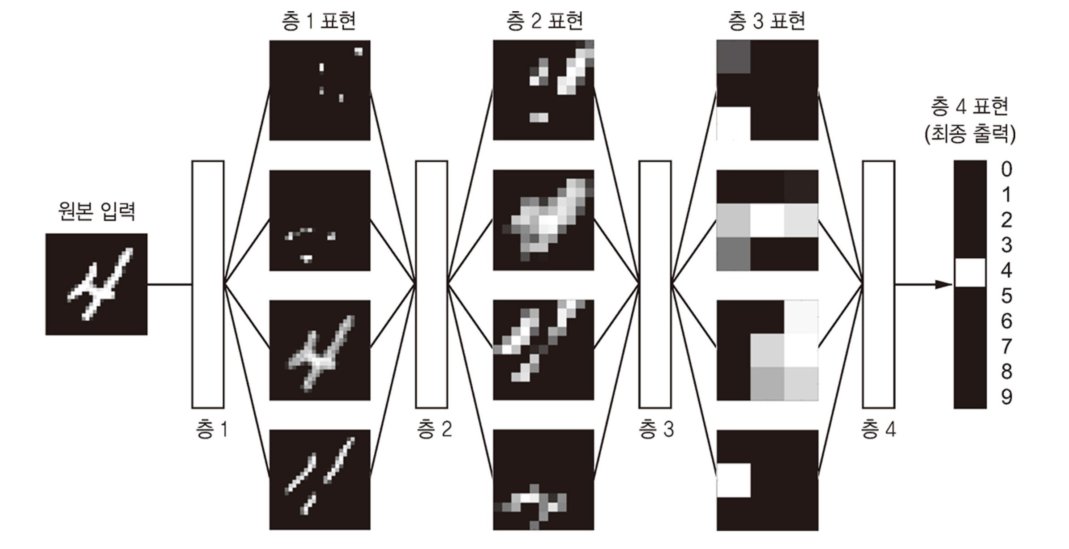
02.
"Artificial intelligence could be the greatest event in human history,
or the worst.
If we are not prepared, it could be the worst.”
By Stephen William Hawking
신경망
그림 출처 : 케라스 창시자에게 배우는 딥러닝 개정 2판

Slide 12
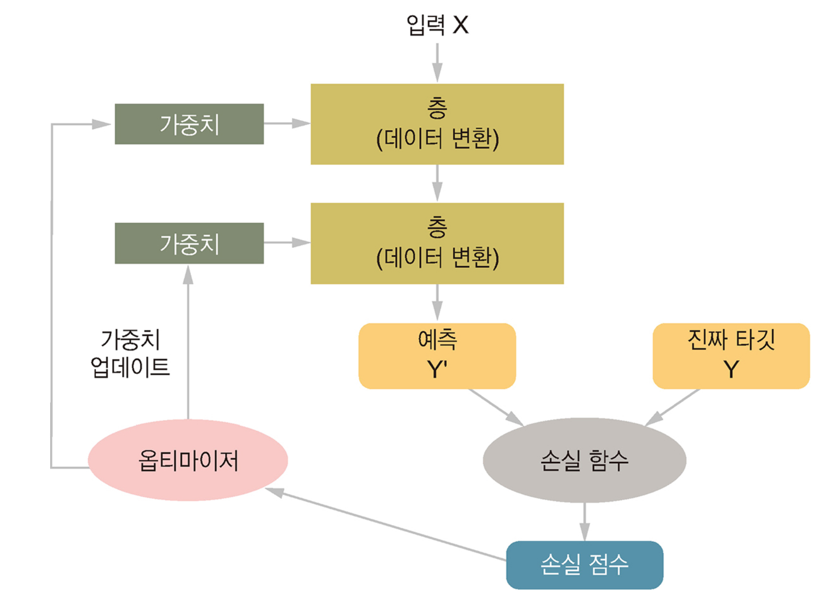
02.
"Artificial intelligence could be the greatest event in human history,
or the worst.
If we are not prepared, it could be the worst.”
By Stephen William Hawking
딥러닝 모델
그림 출처 : 케라스 창시자에게 배우는 딥러닝 개정 2판

Slide 13
02.
"Artificial intelligence could be the greatest event in human history,
or the worst.
If we are not prepared, it could be the worst.”
By Stephen William Hawking
시계열 데이터
시계열 데이터?
TIME SERIES.
일정 시간 간격으로 측정된 데이터의 시간적 순서를 나타내는 데이터
예시 : 주가 / 날씨 등등
연속된 시간 간격 데이터
B.

Slide 14
EDA
03.
CORRELATION ANALYSIS.
TIME-SERIES ANALYSIS.

Slide 15
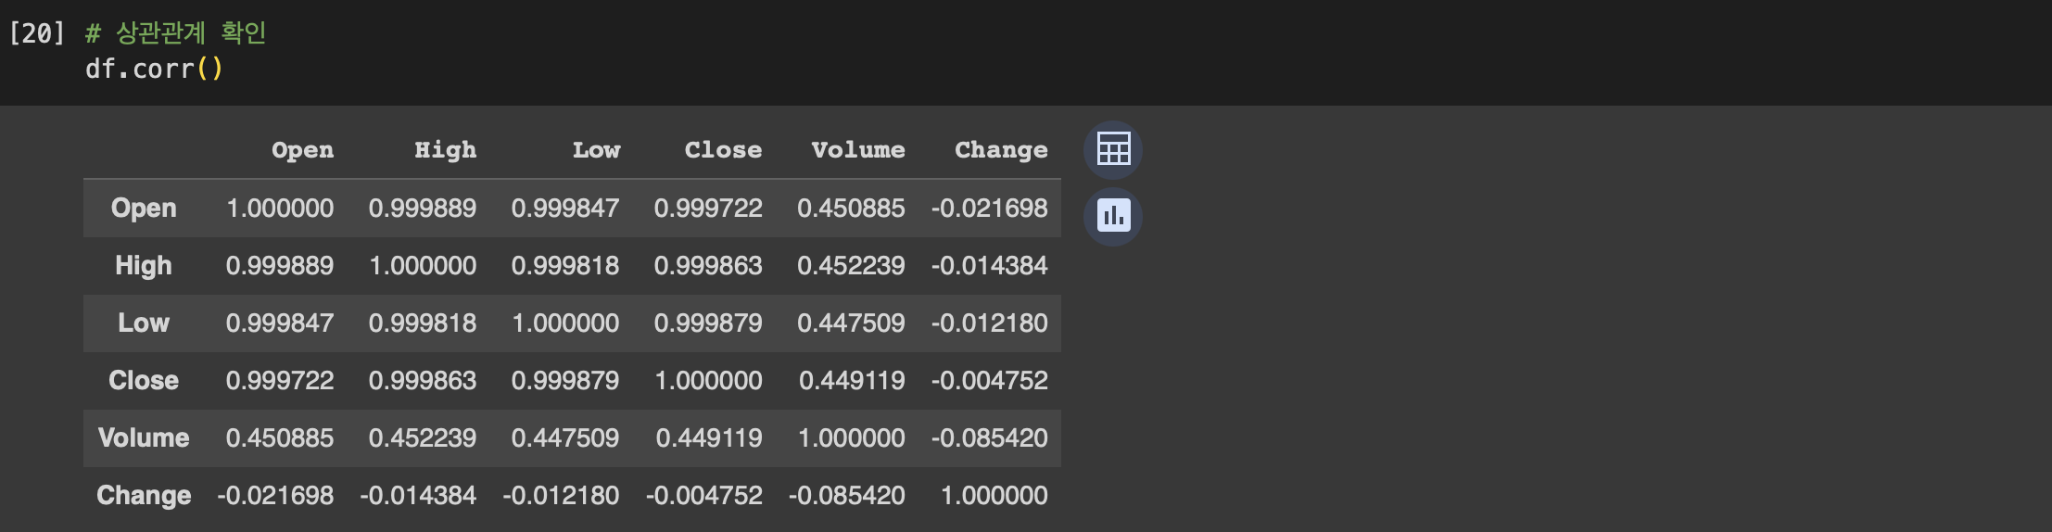
03.
"Artificial intelligence could be the greatest event in human history,
or the worst.
If we are not prepared, it could be the worst.”
By Stephen William Hawking
상관 분석

Slide 16
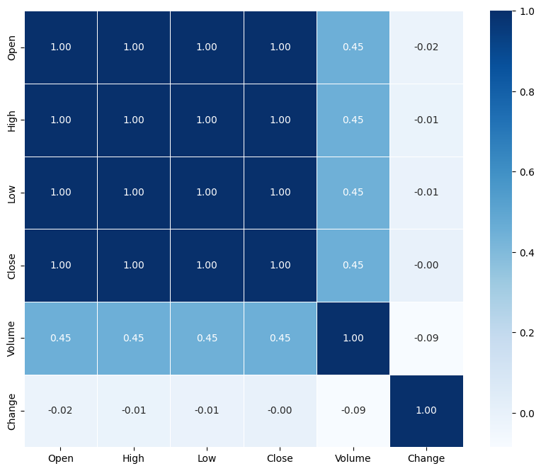
03.
"Artificial intelligence could be the greatest event in human history,
or the worst.
If we are not prepared, it could be the worst.”
By Stephen William Hawking
상관 분석

Slide 17
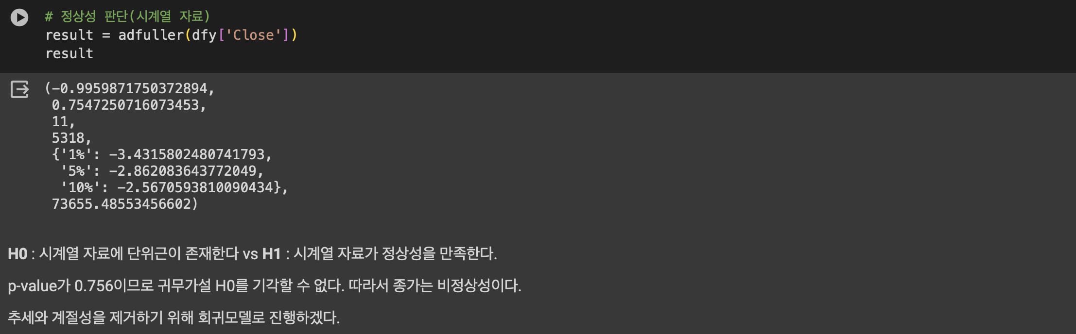
03.
"Artificial intelligence could be the greatest event in human history,
or the worst.
If we are not prepared, it could be the worst.”
By Stephen William Hawking
시계열 분석

Slide 18
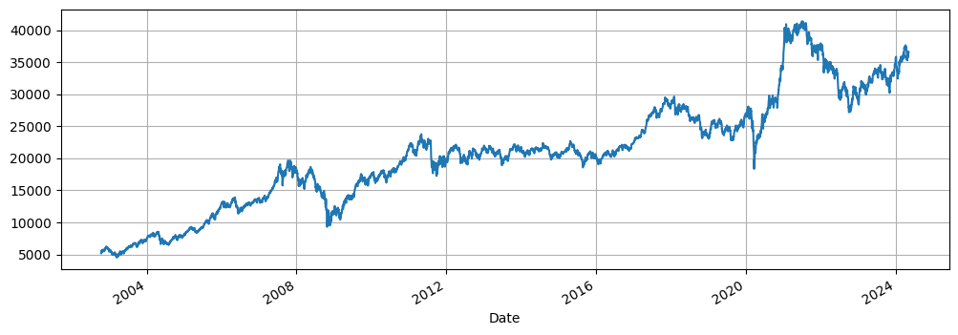
03.
"Artificial intelligence could be the greatest event in human history,
or the worst.
If we are not prepared, it could be the worst.”
By Stephen William Hawking
시계열 분석

Slide 19
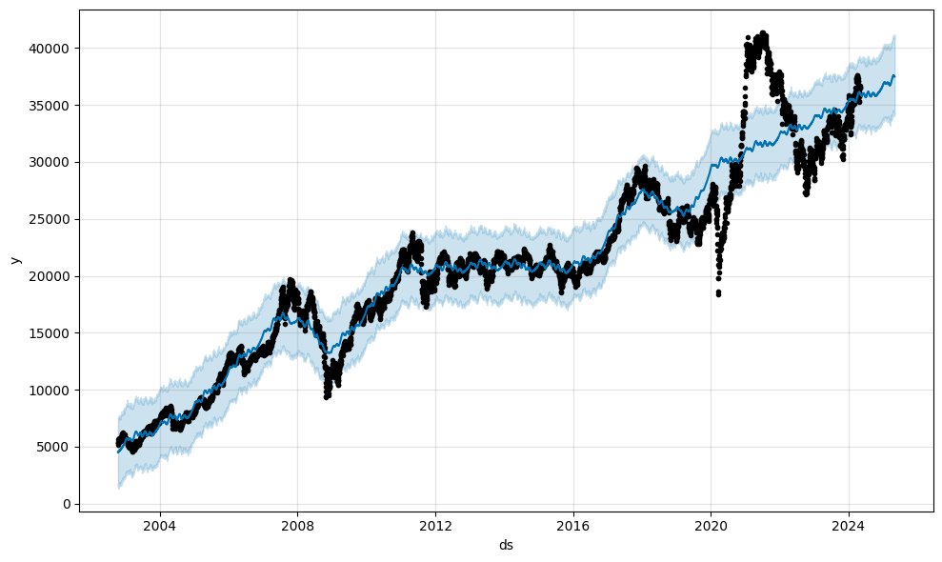
03.
"Artificial intelligence could be the greatest event in human history,
or the worst.
If we are not prepared, it could be the worst.”
By Stephen William Hawking
시계열 분석

Slide 20
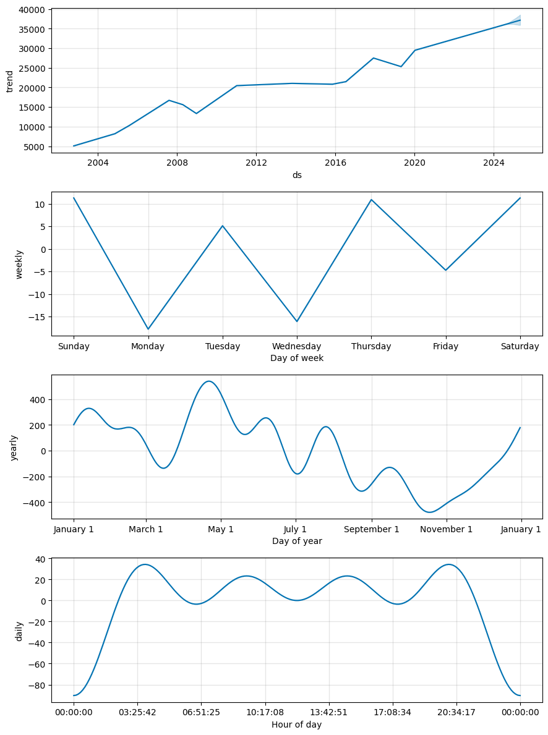
03.
"Artificial intelligence could be the greatest event in human history,
or the worst.
If we are not prepared, it could be the worst.”
By Stephen William Hawking
시계열 분석

Slide 21
Data Scaling & Introduce
04.
ROBUST SCALING.
MODEL.

Slide 22
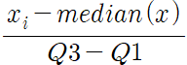
04.
"Artificial intelligence could be the greatest event in human history,
or the worst.
If we are not prepared, it could be the worst.”
By Stephen William Hawking
로버스트
스케일링
ROBUST.
중앙값과 분위수를 활용
이상치의 영향이 적다
중앙값 = 0, IQR = 1
A.
그림 출처 : 케라스 창시자에게 배우는 딥러닝 개정 2판

Slide 23
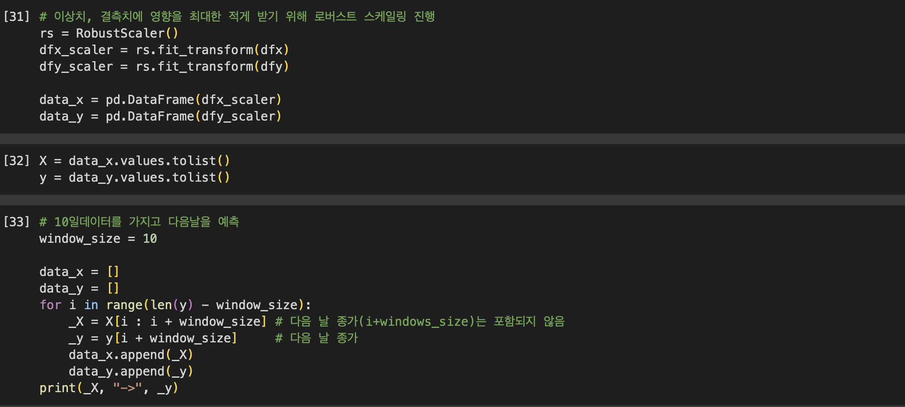
04.
"Artificial intelligence could be the greatest event in human history,
or the worst.
If we are not prepared, it could be the worst.”
By Stephen William Hawking
로버스트
스케일링

Slide 24
04.
"Artificial intelligence could be the greatest event in human history,
or the worst.
If we are not prepared, it could be the worst.”
By Stephen William Hawking
추가 : 단어 설명
샘플 : 모델에 주입 할 데이터 포인트 ex) train_x
예측 : 모델로 부터 나오는 값 ex) pred_y
타깃 : 정답값 ex) test_y
Loss : 모델의 예측값 – 타깃값
units : 반환시킬 차원의 수 , 출력시킬 차원의 수
activation : 활성함수
dropout : 무작위로 층에서 출력된 값을 버림
optimizer : 가중치 최적화 알고리즘
epochs : 학습 횟수
batch_size : 한번에 학습시킬 데이터 수
INFROMATION.
B.

Slide 25
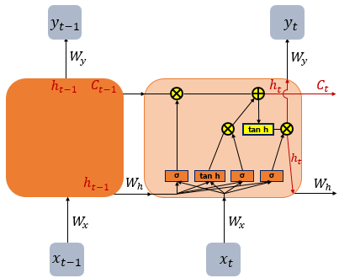
04.
"Artificial intelligence could be the greatest event in human history,
or the worst.
If we are not prepared, it could be the worst.”
By Stephen William Hawking
모델 : LSTM
1. RNN은 장기적 종속성 학습에 문제가 있음
2. 부가적인 게이트를 사용하여 은닉 셀의 어느 정보가
출력과 다음 은닉 상태까지 보내지는지 제어
3. 시계열 데이터의 시간 스텝 간 양방향 종속성 학습
4. 전체 시계열 학습에 유용

Slide 26
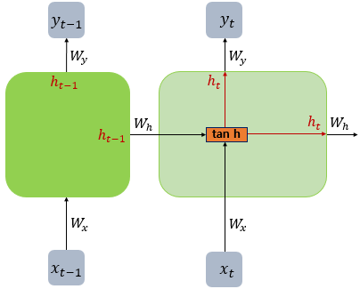
04.
"Artificial intelligence could be the greatest event in human history,
or the worst.
If we are not prepared, it could be the worst.”
By Stephen William Hawking
모델 : RNN(바닐라)
1. 과거의 정보를 사용하여 현재, 미래 입력에 대한
신경망의 성능을 개선하는 딥러닝 구조
2. 은닉상태, 루프 존재
3. 루프 구조를 통해 신경망은 은닉 상태에 과거 저장

Slide 27
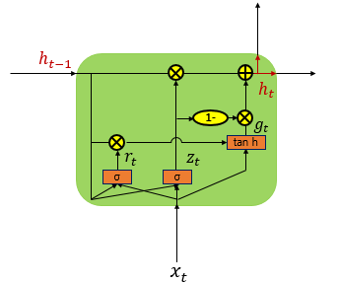
04.
"Artificial intelligence could be the greatest event in human history,
or the worst.
If we are not prepared, it could be the worst.”
By Stephen William Hawking
모델 : GRU
1. LSTM 네트워크를 개선하기 위한 모델
2. 두 개의 게이트를 사용 하여 계산 효율
3. 빠른 학습 시간, 낮은 계산 복잡성
그림 출처 : 케라스 창시자에게 배우는 딥러닝 개정 2판

Slide 28

04.
"Artificial intelligence could be the greatest event in human history,
or the worst.
If we are not prepared, it could be the worst.”
By Stephen William Hawking
모델 : Transformer
1. 구글에서 개발
2. seq2seq구조인 인코더, 디코더를 따름
3. Attention만으로 구현한 모델,
4. RNN을 전혀 사용하지 않지만 우수한 성능
5. GPT4의 기반

Slide 29
LSTM
05.
MODEL, COMPILE, FIT, PREDICT.
PLOT.

Slide 30
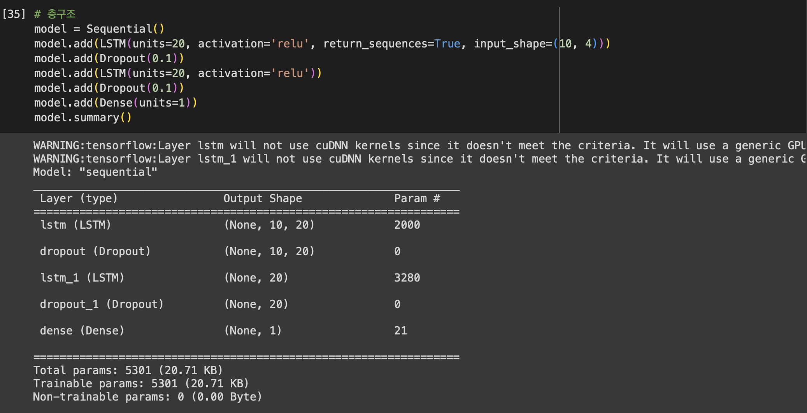
05.
"Artificial intelligence could be the greatest event in human history,
or the worst.
If we are not prepared, it could be the worst.”
By Stephen William Hawking
모델링

Slide 31
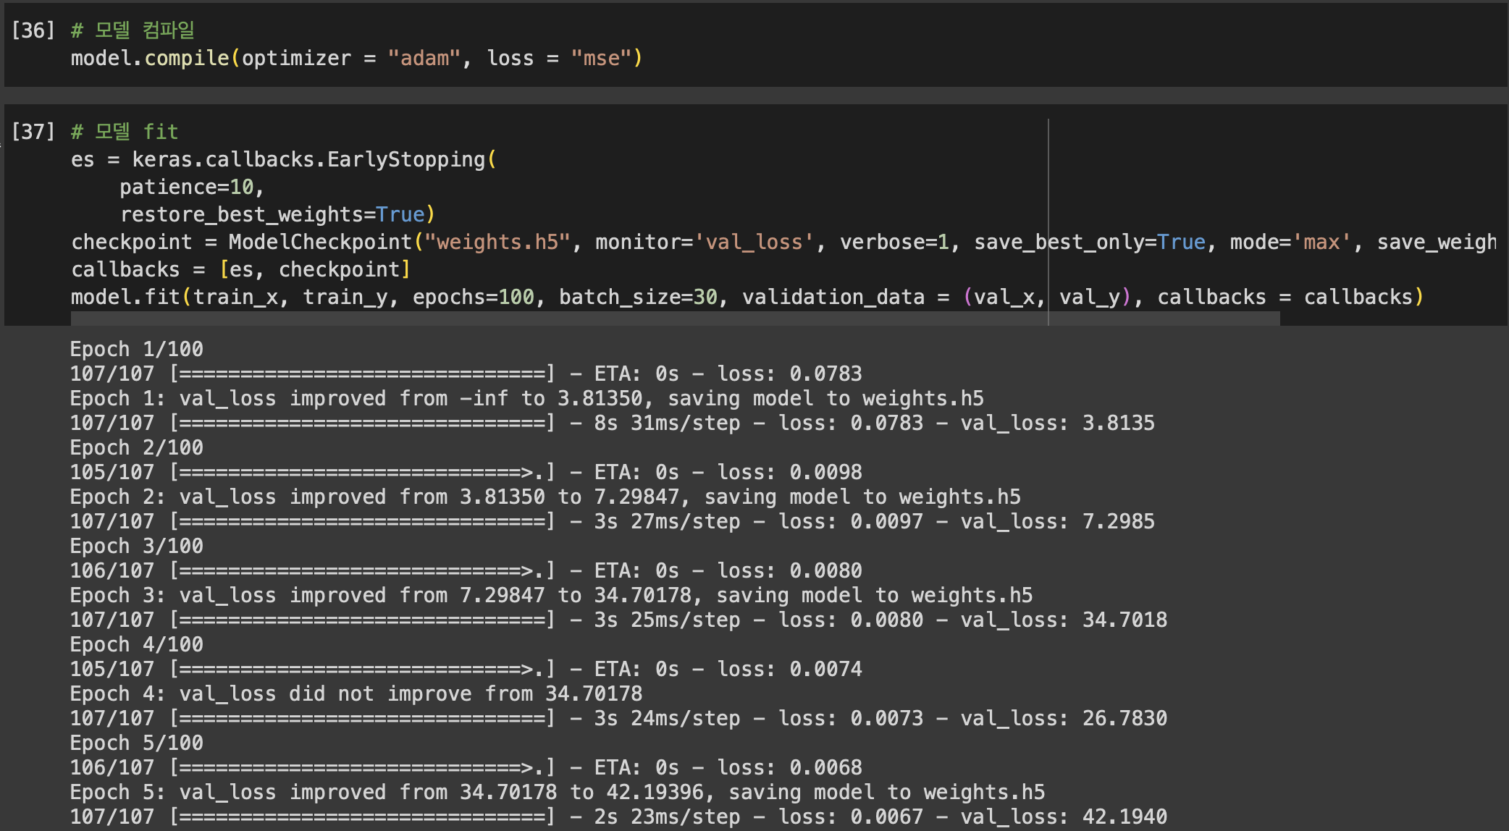
05.
"Artificial intelligence could be the greatest event in human history,
or the worst.
If we are not prepared, it could be the worst.”
By Stephen William Hawking
컴파일, FIT

Slide 32
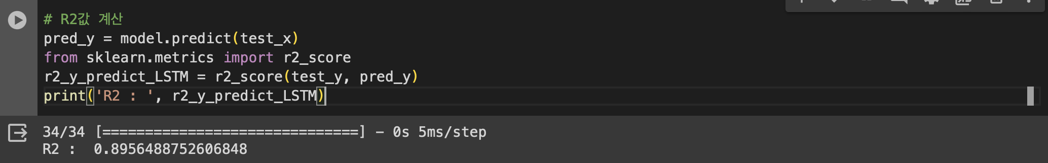

05.
"Artificial intelligence could be the greatest event in human history,
or the worst.
If we are not prepared, it could be the worst.”
By Stephen William Hawking
Predict

Slide 33
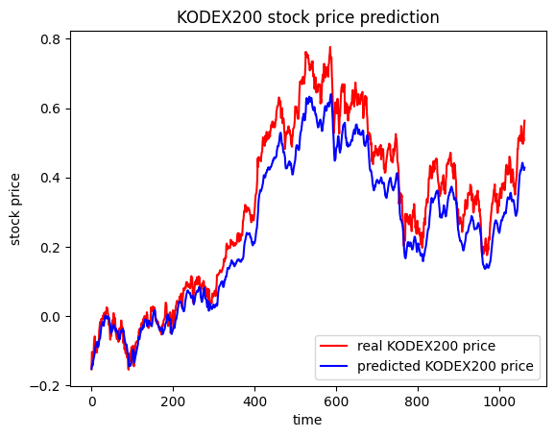
05.
"Artificial intelligence could be the greatest event in human history,
or the worst.
If we are not prepared, it could be the worst.”
By Stephen William Hawking
PLOT

Slide 34
RNN
06.
MODEL, COMPILE, FIT, PREDICT.
PLOT.

Slide 35
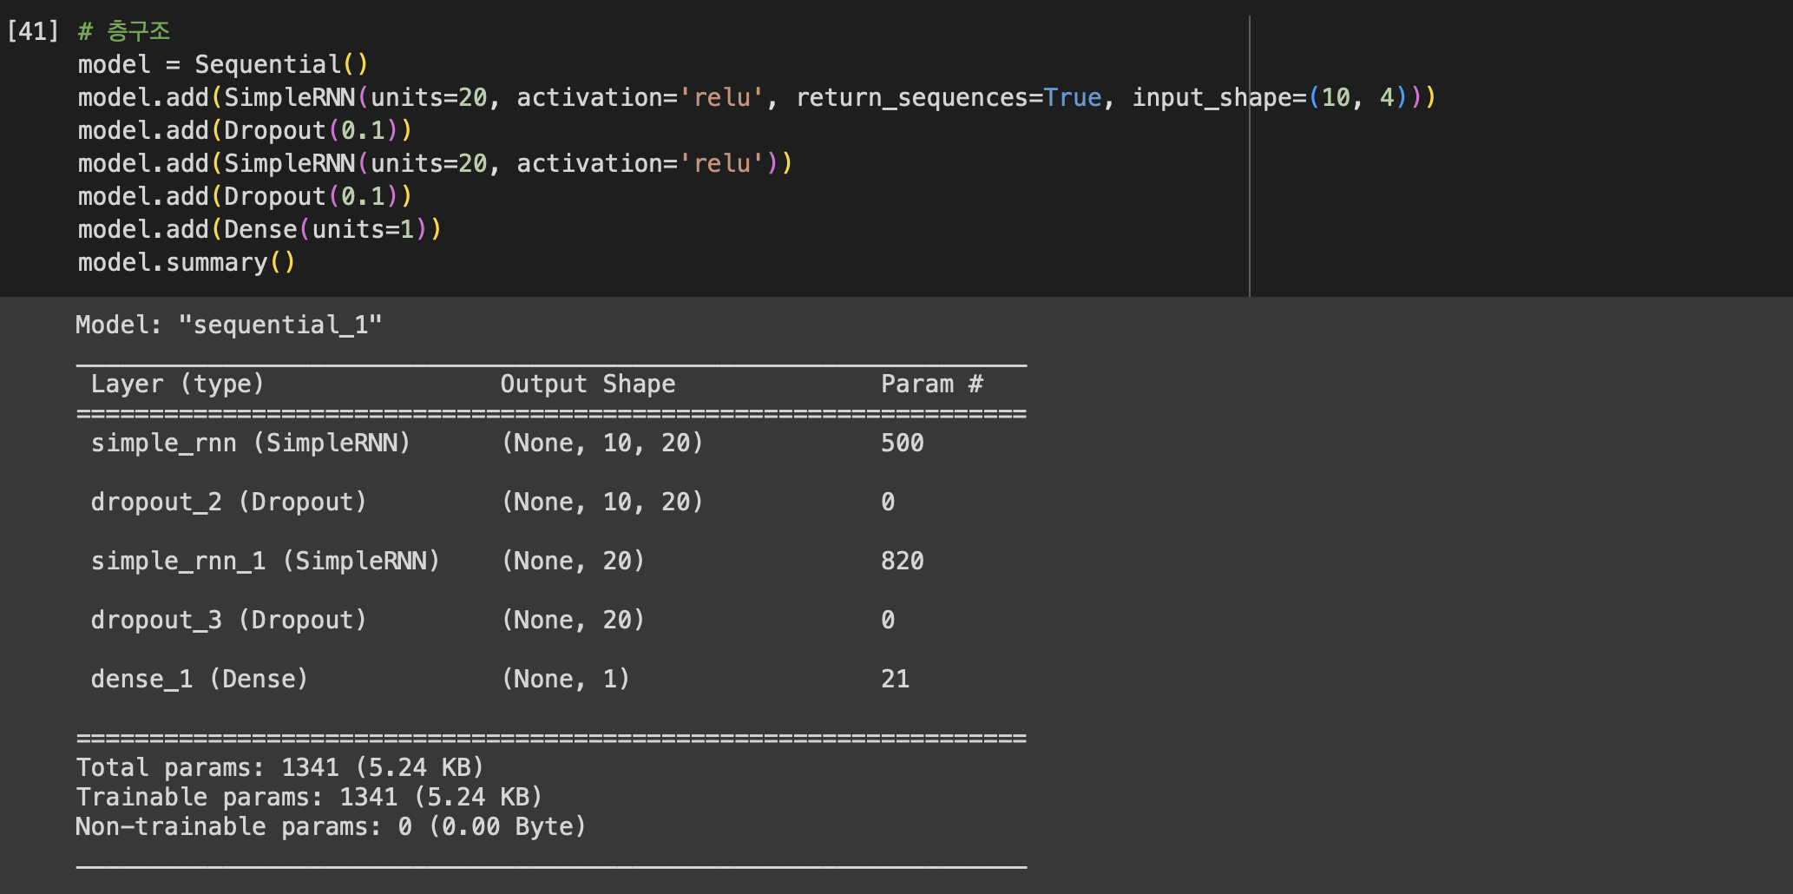
06.
"Artificial intelligence could be the greatest event in human history,
or the worst.
If we are not prepared, it could be the worst.”
By Stephen William Hawking
모델링

Slide 36
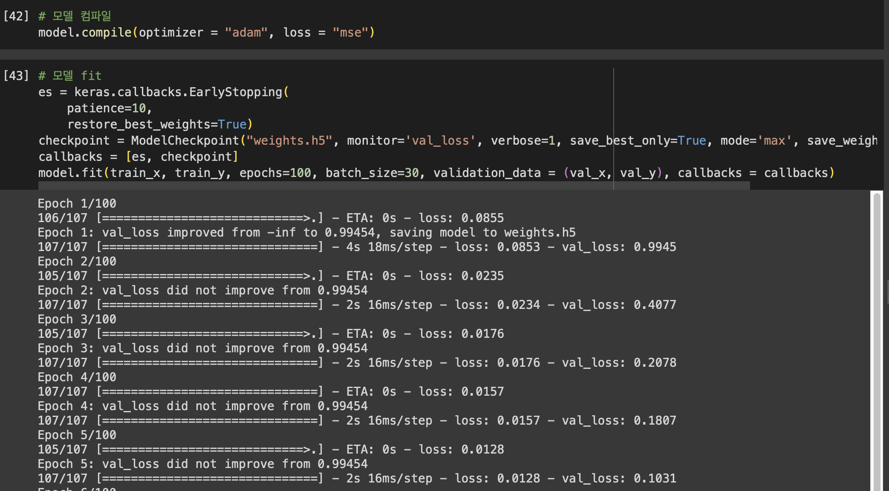
06.
"Artificial intelligence could be the greatest event in human history,
or the worst.
If we are not prepared, it could be the worst.”
By Stephen William Hawking
컴파일, FIT

Slide 37
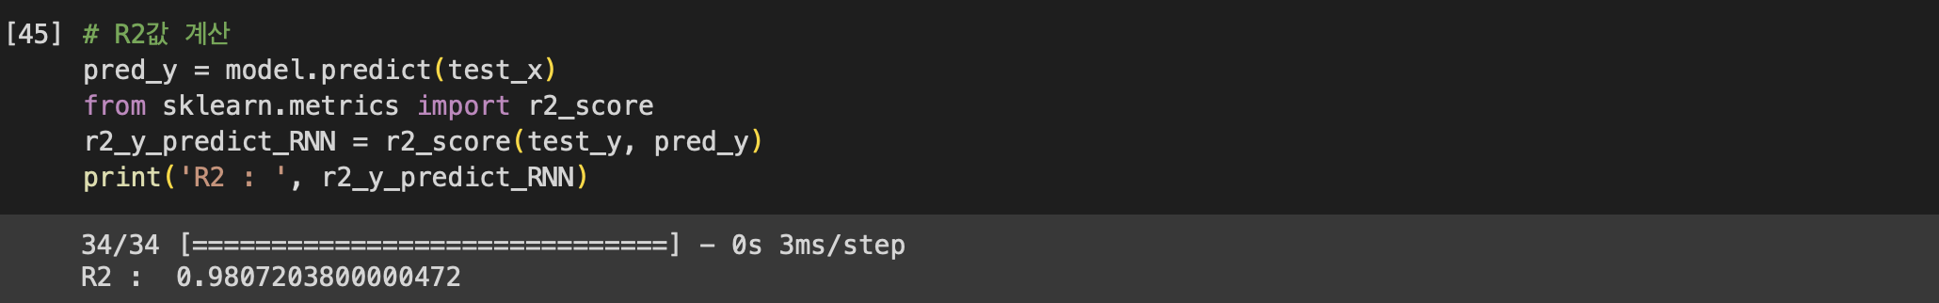
06.
"Artificial intelligence could be the greatest event in human history,
or the worst.
If we are not prepared, it could be the worst.”
By Stephen William Hawking
Predict

Slide 38
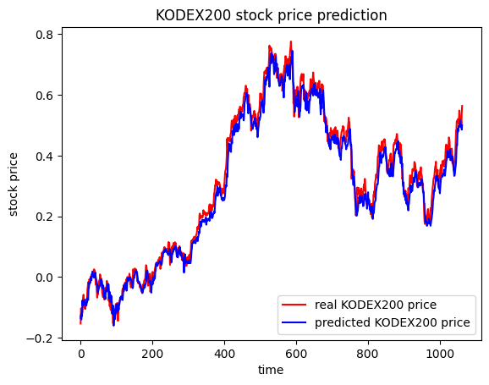
06.
"Artificial intelligence could be the greatest event in human history,
or the worst.
If we are not prepared, it could be the worst.”
By Stephen William Hawking
PLOT

Slide 39
GRU
07.
MODEL, COMPILE, FIT, PREDICT.
PLOT.

Slide 40
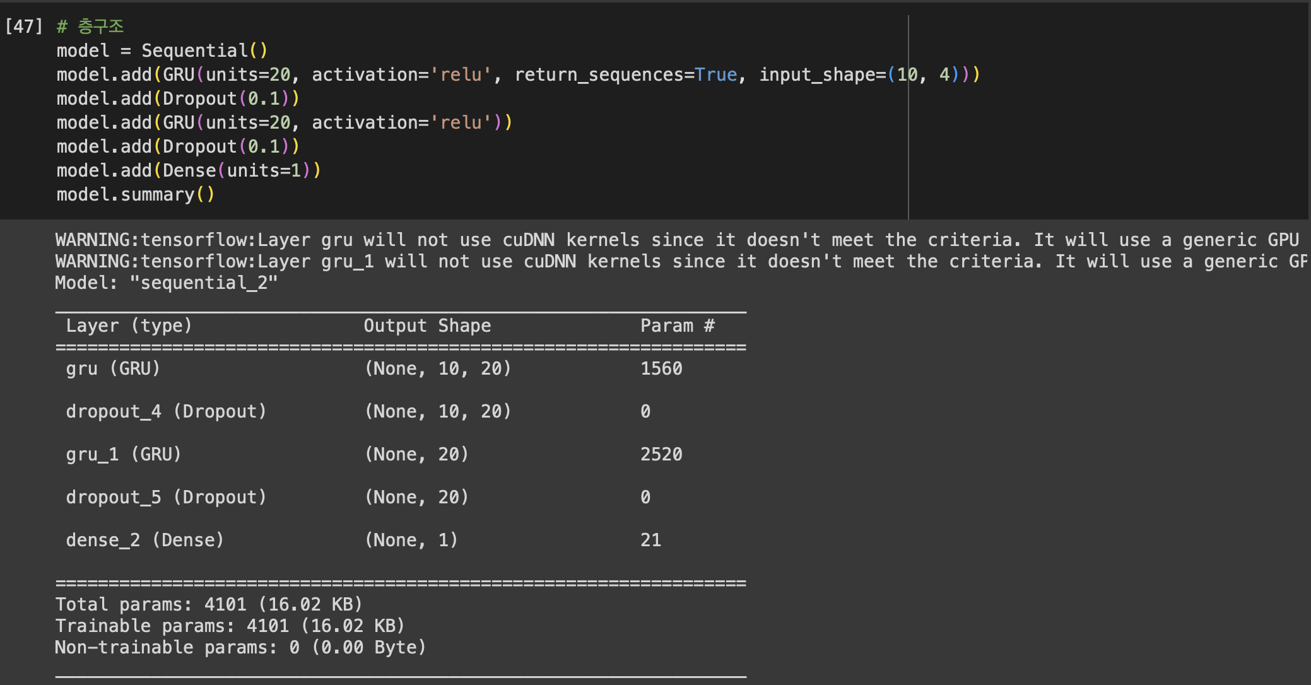
07.
"Artificial intelligence could be the greatest event in human history,
or the worst.
If we are not prepared, it could be the worst.”
By Stephen William Hawking
모델링

Slide 41
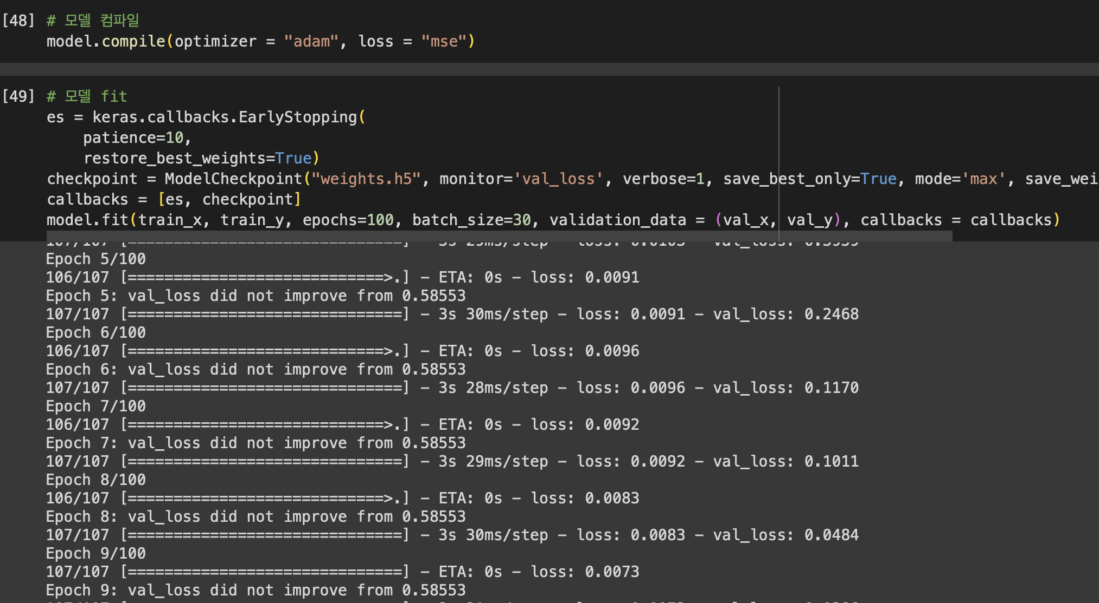
07.
"Artificial intelligence could be the greatest event in human history,
or the worst.
If we are not prepared, it could be the worst.”
By Stephen William Hawking
컴파일, FIT

Slide 42
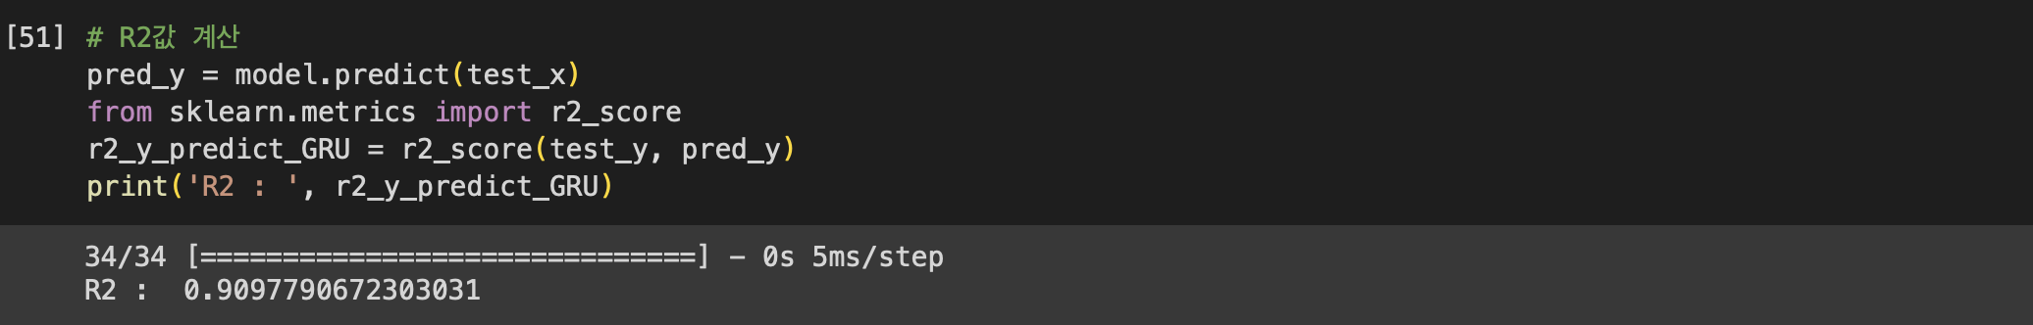
07.
"Artificial intelligence could be the greatest event in human history,
or the worst.
If we are not prepared, it could be the worst.”
By Stephen William Hawking
Predict

Slide 43
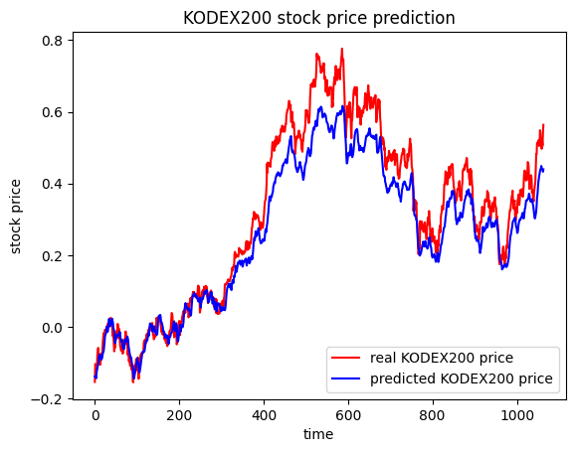
07.
"Artificial intelligence could be the greatest event in human history,
or the worst.
If we are not prepared, it could be the worst.”
By Stephen William Hawking
PLOT

Slide 44
Transformer
08.
MODEL, COMPILE, FIT, PREDICT.
PLOT.

Slide 45
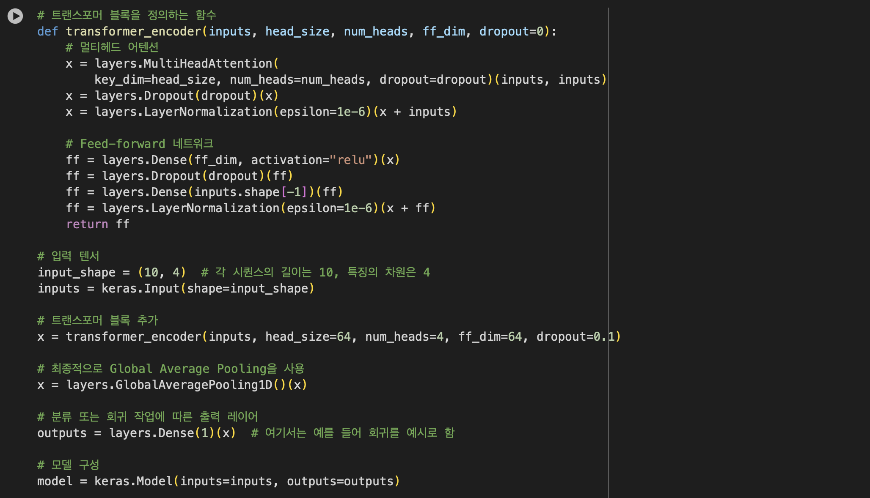
08.
"Artificial intelligence could be the greatest event in human history,
or the worst.
If we are not prepared, it could be the worst.”
By Stephen William Hawking
모델링

Slide 46
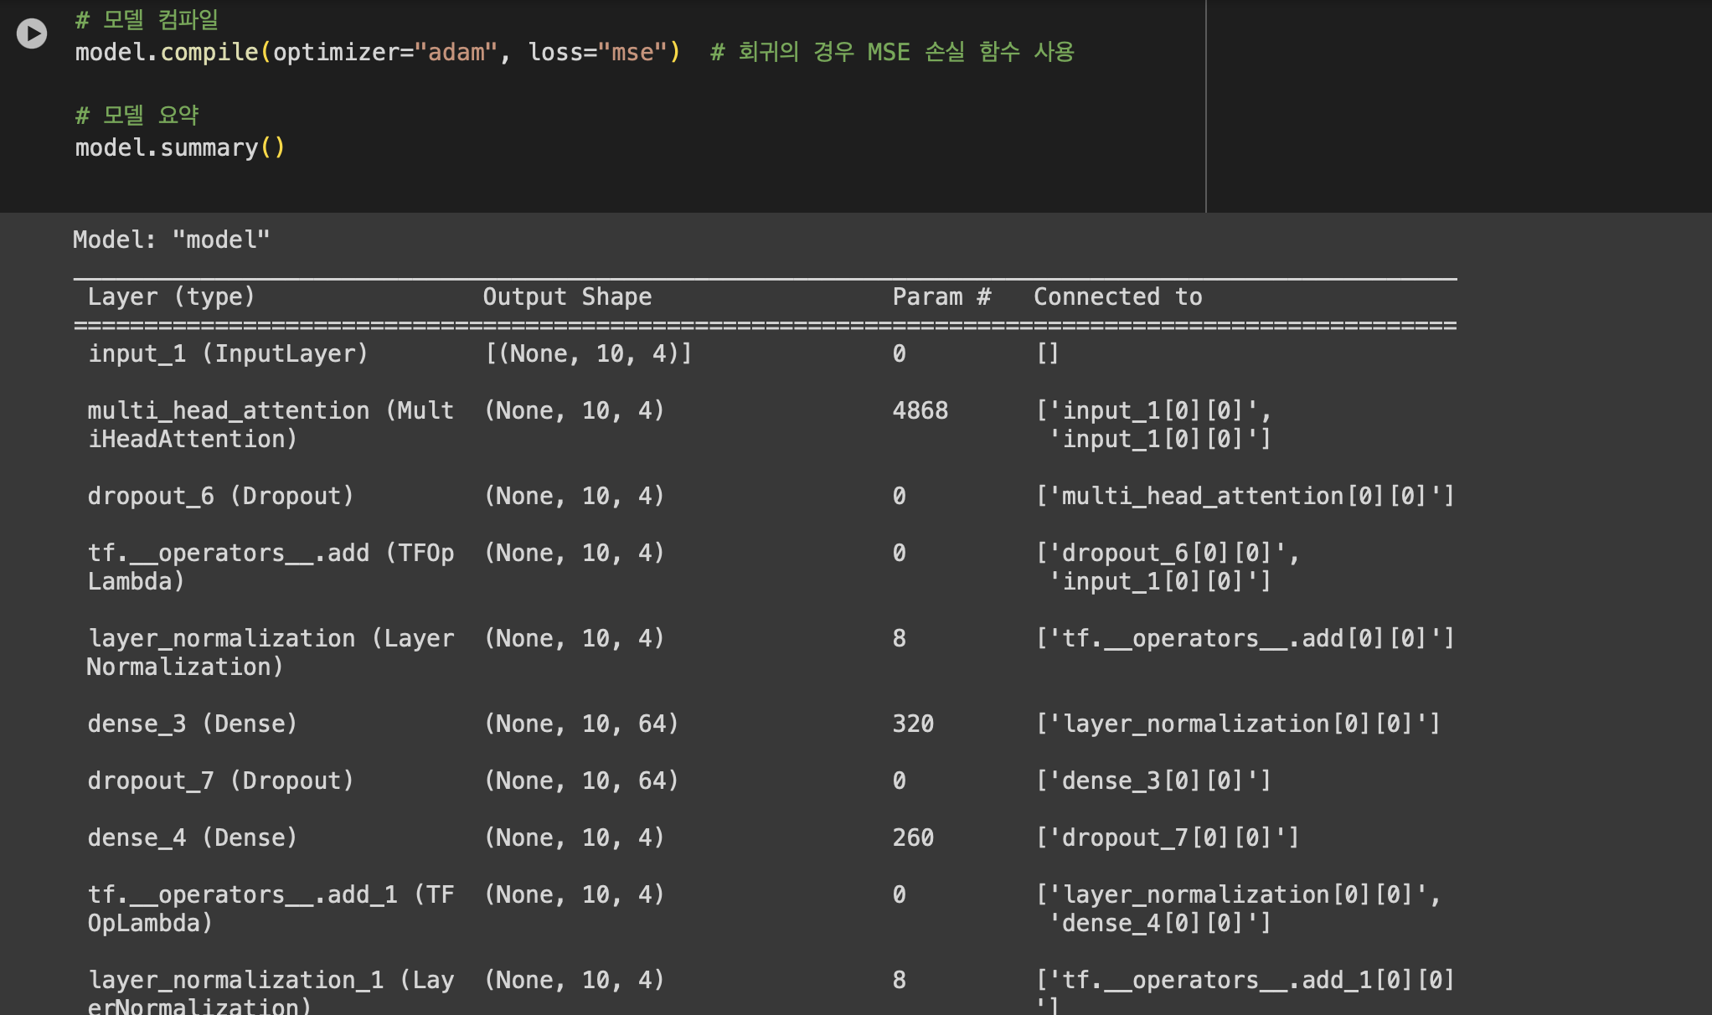
08.
"Artificial intelligence could be the greatest event in human history,
or the worst.
If we are not prepared, it could be the worst.”
By Stephen William Hawking
컴파일

Slide 47
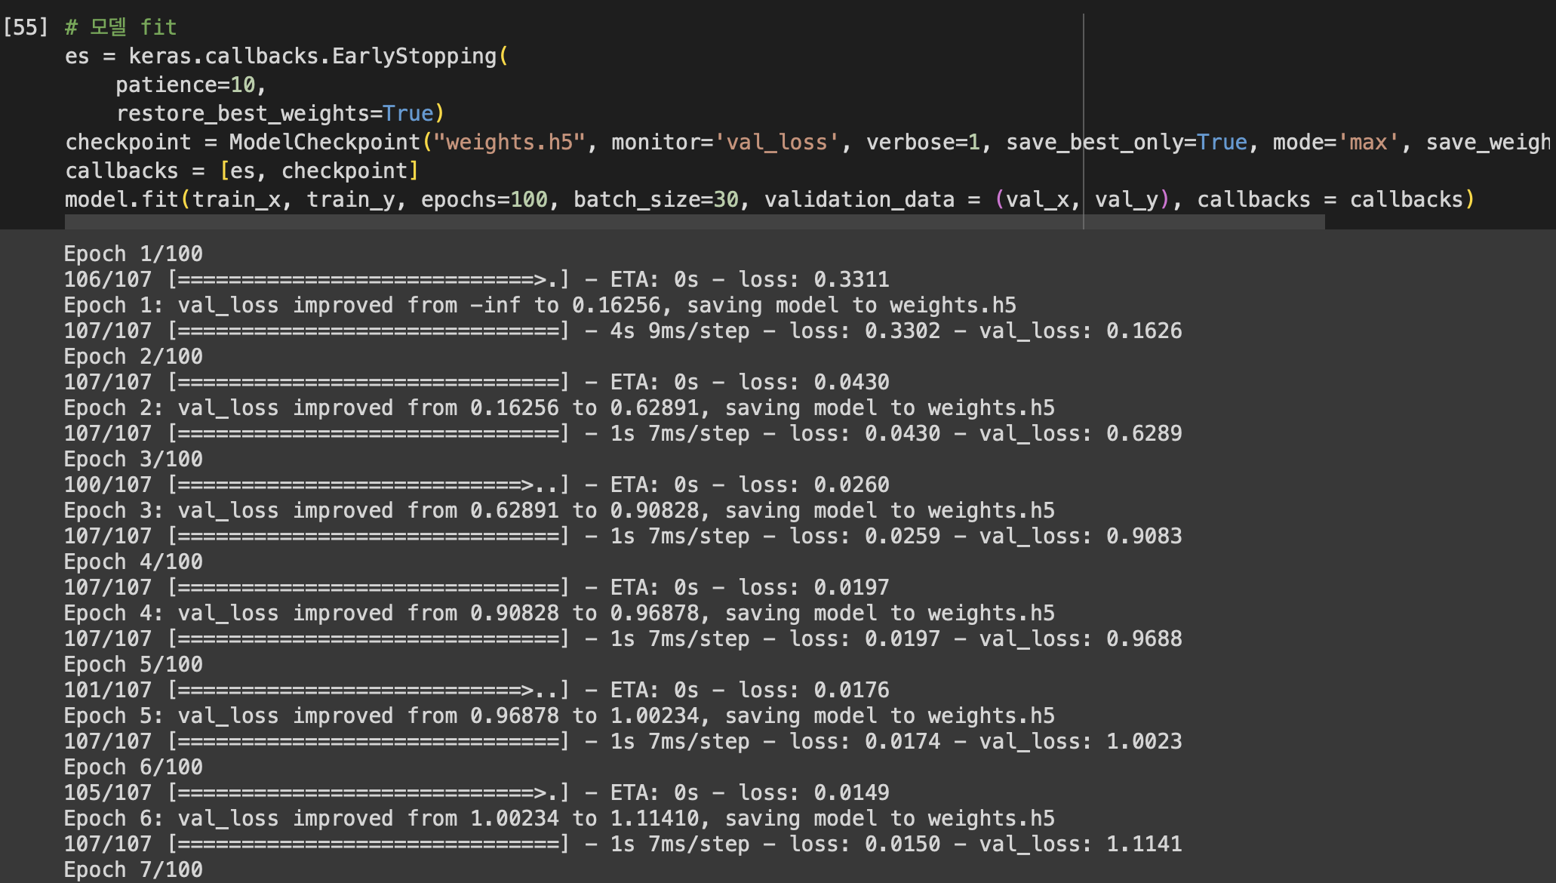
08.
"Artificial intelligence could be the greatest event in human history,
or the worst.
If we are not prepared, it could be the worst.”
By Stephen William Hawking
FIT

Slide 48
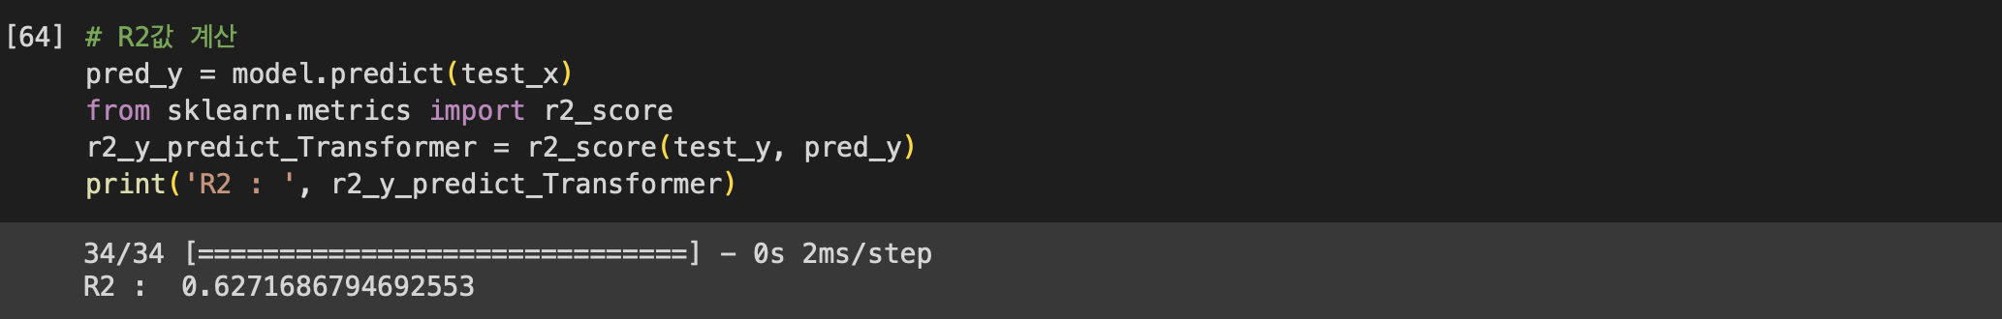
08.
"Artificial intelligence could be the greatest event in human history,
or the worst.
If we are not prepared, it could be the worst.”
By Stephen William Hawking
Predict
D.

Slide 49
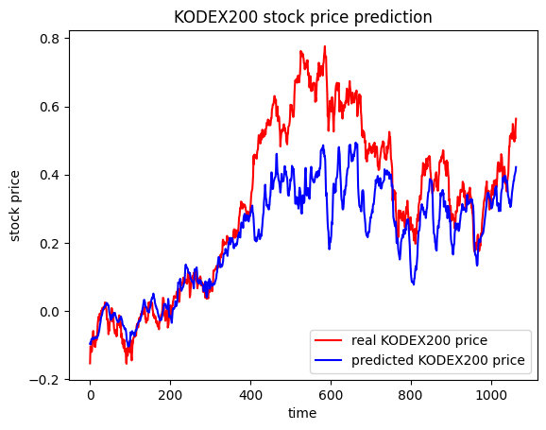
08.
"Artificial intelligence could be the greatest event in human history,
or the worst.
If we are not prepared, it could be the worst.”
By Stephen William Hawking
PLOT

Slide 50
Conclusion
09.
R SQUARED.
PREDICTIONS.

Slide 51
09.
"Artificial intelligence could be the greatest event in human history,
or the worst.
If we are not prepared, it could be the worst.”
By Stephen William Hawking
R squared
LSTM : 0.896
2021 : 2,980
RNN : 0.981
GRU : 0.910
Transformer : 0.422
R squared

Slide 52
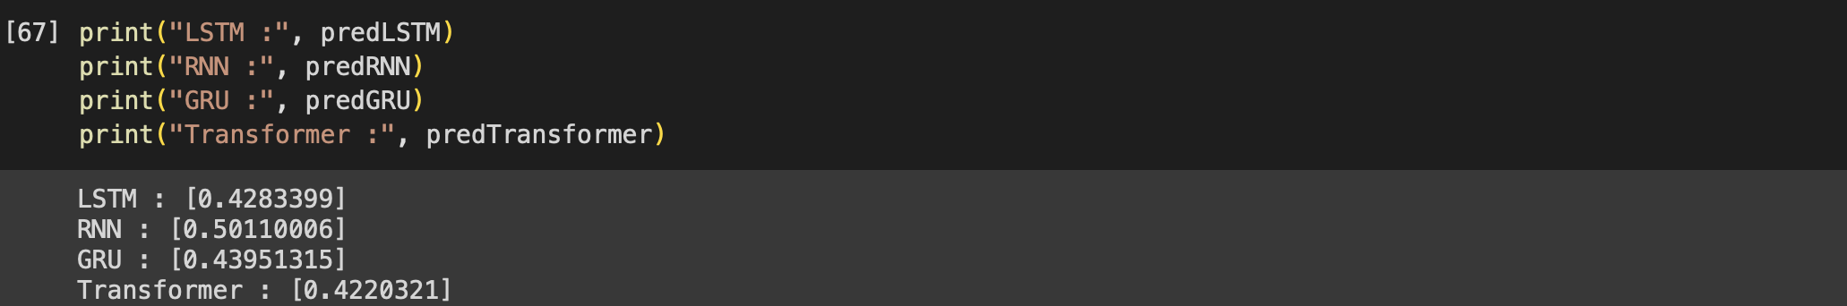
09.
"Artificial intelligence could be the greatest event in human history,
or the worst.
If we are not prepared, it could be the worst.”
By Stephen William Hawking
예측 값

Slide 53
QNA
09.

Slide 54
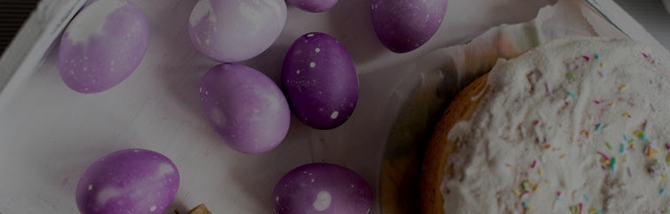
09.
"Artificial intelligence could be the greatest event in human history,
or the worst.
If we are not prepared, it could be the worst.”
By Stephen William Hawking
Q n A
참고만! 투자시 소액만!

Slide 55
THX.
HRD
FINANCE
BY TAE YOUNG

